Slide 1
Image Super-Resolution Using Deep Convolutional Networks
Chao Dong, Chen Change Loy, Member, IEEE, Kaiming He, Member, IEEE, and Xiaoou Tang, Fellow, IEEE

Slide 2
Outline
Introduction
Convolutional Neural Networks for Super-Resolution
Experiments
Conclusion

Slide 3
Introduction
Single image super-resolution (SR) aims at recovering a high-resolution image from a single low-resolution image.
Recent state-of-the-art methods mostly adopt the example-based strategy.
The sparse-coding-based method, is one of the representative external example-based SR methods.
Notes:
图像超分辨率是指由一幅低分辨率图像恢复出高分辨率图像
基于实例的方法：利用相同图像的内部相似性,或者从高低分辨率图像对中学习出映射函数。
基于稀疏编码的方法的做法是：1.从输入图像中有重叠的扣取pach，2.把pach利用一个字典编码，3.吧稀疏系数映射到高分辨率的字典。
最后，生成输出。
这种方法我们把精力都集中到了字典的建立，以及映射函数的建立了，而忽视了其他步骤的优化。

Slide 4
Introduction
Overall, the contributions of this study are mainly in three aspects:
We present a fully convolutional neural net-work for image super-resolution.
We establish a relationship between our deep-learning-based SR method and the traditional sparse-coding-based SR methods.
Notes:
而本文，作者提出了利用卷积神经网络来解决超分辨率的问题。使其自己学习最优的映射函数以及字典。

Slide 5
Introduction
We demonstrate that deep learning is useful in the classical computer vision problem of super-resolution, and can achieve good quality and speed.

Slide 6
Convolutional Neural Networks for Super-Resolution
Formulation
Relationship to Sparse-Coding-Based Methods
Training

Slide 7
Formulation
Consider a single low-resolution image, we ﬁrst upscale it to the desired size.
Let us denote the interpolated image as Y.
Our goal is to recover from Y an image F(Y) that is as similar as possible to the ground truth high-resolution image X .

Slide 8
Formulation
We wish to learn a mapping F, which conceptually consists of three operations:
Patch extraction and representation
Non-linear mapping
Reconstruction

Slide 9

Formulation
Our ﬁrst layer is expressed as an operation F1 :
W1 corresponds to n1 ﬁlters of support c×f1×f1 ,where c is the number of channels in the input image,f1 is the spatial size of a ﬁlter.
Notes:
直观的来看就是在图像y上使用n1个卷积核进行卷积

Slide 10
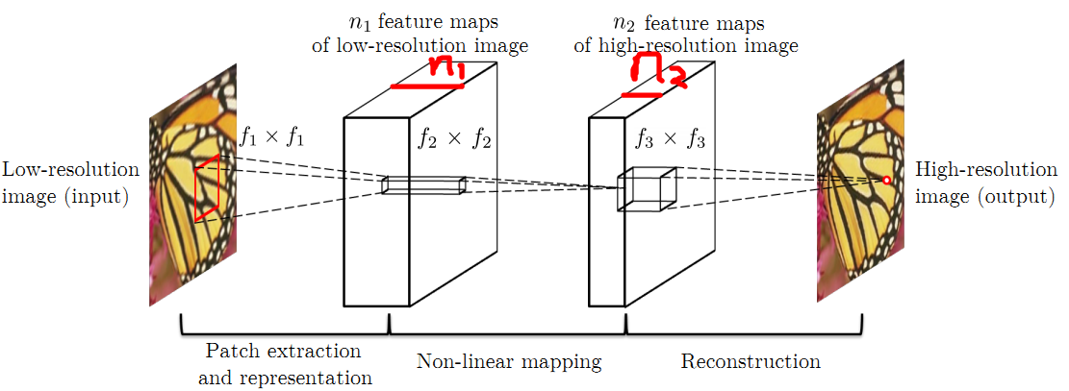
Formulation

Slide 11
Formulation
The ﬁrst layer extracts an n1-dimensional feature for each patch.
In the second operation, we map each of these n1-dimensional vectors into an n2 –dimensional one.
This is equivalent to applying n2 ﬁlters which have a spatial support 1×1.

Slide 12

Formulation
The operation of the second layer is:
W2 contains n2 ﬁlters of size n1×f2×f2

Slide 13

Formulation
We deﬁne a convolutional layer to produce the ﬁnal high-resolution image:
W3 corresponds to c ﬁlters of a size n2×f3×f3

Slide 14
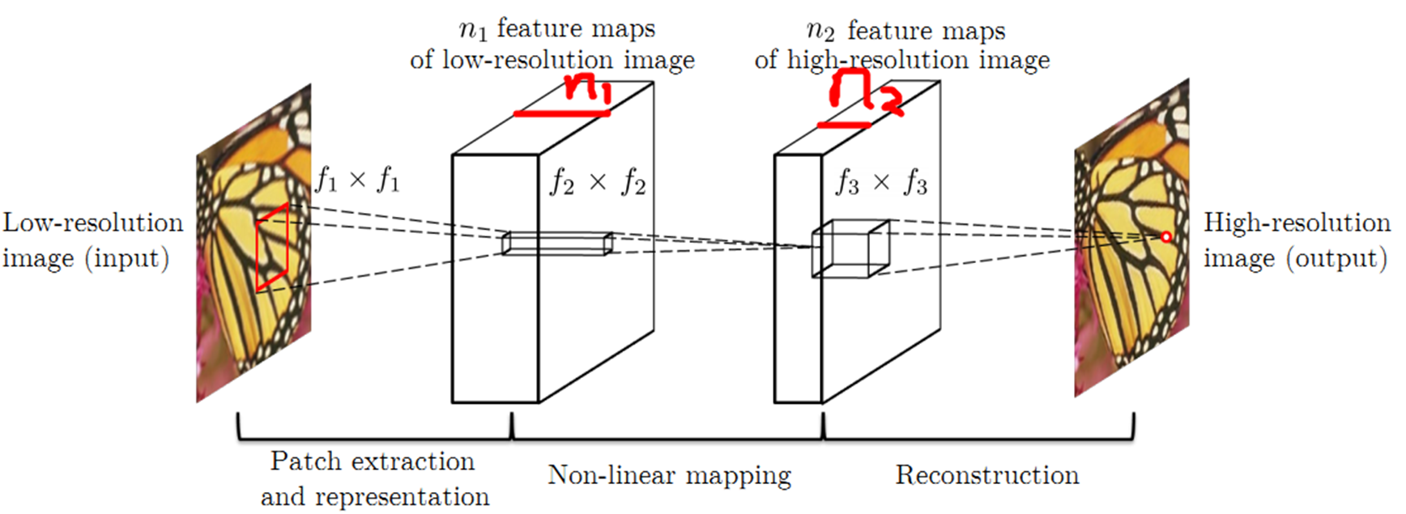
Formulation

Slide 15
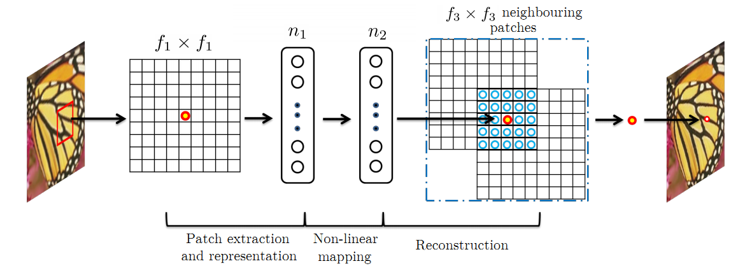
Relationship to Sparse-Coding-Based Methods

Slide 16

Relationship to Sparse-Coding-Based Methods

Slide 17
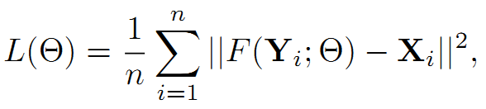
Training
Given a set of high-resolution images {Xi} and their corresponding low-resolution images {Yi}, we use Mean Squared Error (MSE) as the loss function:

Slide 18
Experiments
We ﬁrst investigate the impact of using different datasets on the model performance.
Next, we examine the ﬁlters learned by our approach.

Slide 19
Experiments
We then explore different architecture designs of the network, and study the relations between super-resolution performance and factors like depth, number of ﬁlters, and ﬁlter sizes.
Subsequently, we compare our method with recent state-of-the-arts both quantitatively and qualitatively.

Slide 20
Training Data
A small training set that consists of 91 images,
and a large training set that consists of 395,909 images from the ILSVRC 2013 ImageNet detection training partition.

Slide 21
Training Data
We use the basic network settings, i.e., f1 = 9,f2 = 1, f3 = 5, n1 = 64, c = 1, and n2 = 32.

Slide 22
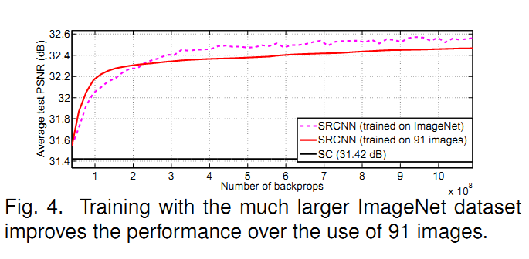
Training Data

Slide 23
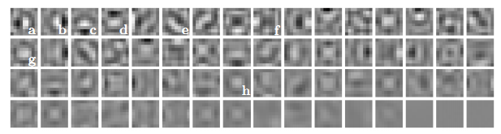
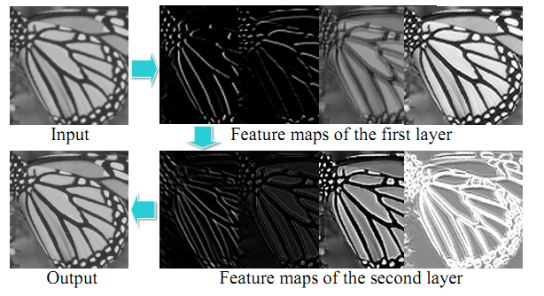
Learned Filters for Super-Resolution

Slide 24
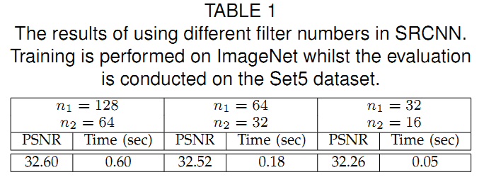
Model and Performance Trade-offs
Filter number

Slide 25
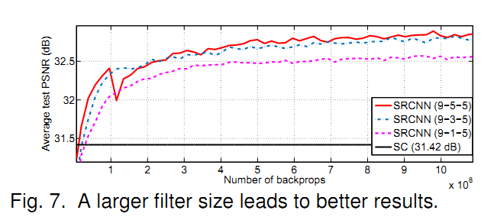
Model and Performance Trade-offs
Filter size

Slide 26
Model and Performance Trade-offs
Number of layers
we try deeper structures by adding another non-linear mapping layer, which has n22 = 16 ﬁlters with size f22 = 1.

Slide 27
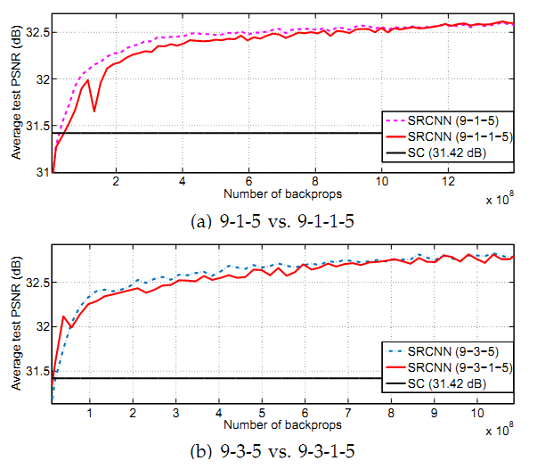

Slide 28
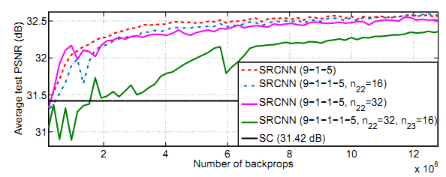

Slide 29
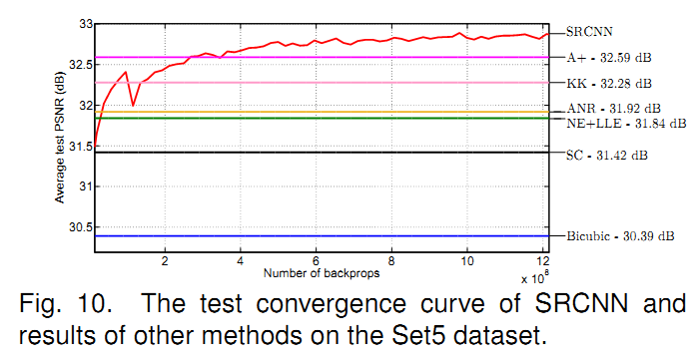
Comparisons to State-of-the-Arts

Slide 30
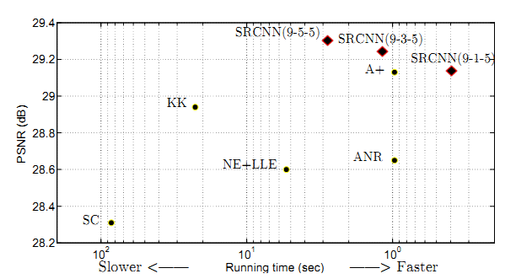
Comparisons to State-of-the-Arts

Slide 31
Conclusion
We have presented a novel deep learning approach for single image super-resolution (SR).
We show that conventional sparse-coding-based SR methods can be reformulated into a deep convolutional neural network.

Slide 32
Conclusion
The SRCNN has achieved superior performance than the state-of-the-art methods.

Slide 33
Thanks!
Q&A

